Slide 1
SPRING FRAMEWORK
Instructor: DieuNT1

Slide 2
Table Content
1
Overview of the Spring Framework
2
Spring IoC
3
Spring Bean
Dependency Injection
4
5
SpEL

Slide 3
Learning Goals
After the course, attendees will be able to:
Understand Spring Framework and its core technologies.
Know how to write a Web application with Spring Framework.

Slide 4
Overview of the Spring Framework
Section 1

Slide 5
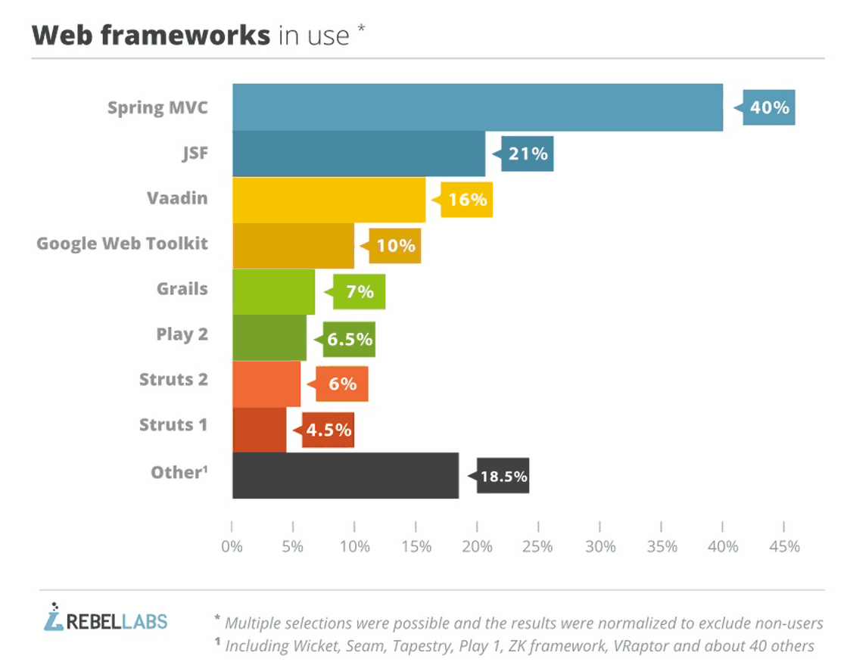

Introduction (1/2)
The Spring Framework is a Java platform that provides comprehensive infrastructure support for developing Java applications.
Spring framework is one of the most popular application development frameworks used by java developers.
Notes:
Spring Framework ra xuất phát từ sự thành công của EJB (Enterprise JavaBean)- một kiến trúc phát triển dành cho các ứng dụng doanh nghiệp có tính mở rộng cao;
Phát triển năm 2002 bởi Rod Johnson. “J2EE Development without EJB”
Theo một số nguồn, trên 50% các ứng dụng web Java hiện nay đang sử dụng Spring.
Đơn giản hóa công việc phát triển thông qua việc sử dụng các đối tượng Java đơn giản hay còn được gọi là POJO (Plain Old Java Object)
Sử dụng DI và interface;
Sử dụng convention và aspect (quy tắc chung);
One of the chief advantages of the Spring framework is its layered architecture.
You can be selective about which of its components you use while also providing a cohesive framework for J2EE application development

Slide 6
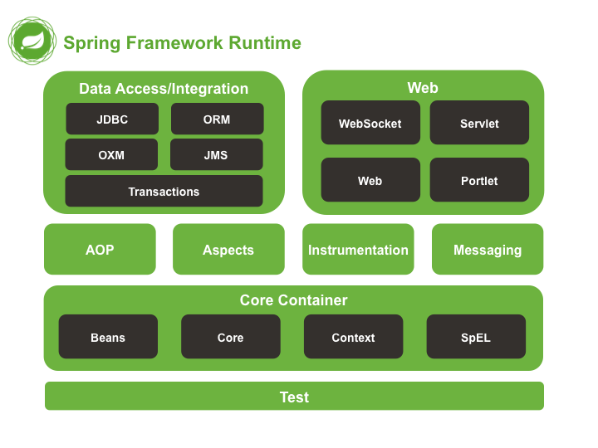
Introduction (2/2)
It consists of a large number of modules providing a range of services:
Core Container;
Data Access/Integration;
Web;
Test.
AOP (Aspect Oriented Programming);
Instrumentation;
Messaging;
Notes:
Trong nhiều năm, Spring Framework phát triển đáng kể;
Trong hầu hết các hệ thống/ứng dụng doanh nghiệp có sử dụng Spring Framework;

Slide 7
Modules (1/3)
Data Access/Integration
JDBC module provides a JDBC-abstraction layer
ORM (object-relational mapping APIs): integrate with JPA, JDO, Hibernate, and iBatis.
OXM (Object/XML mapping) implemente for JAXB, Castor, XMLBeans, JiBX and XStream.
JMS (Java messaging service): producing and consuming messages.
Transaction: supports programmatic and declarative transaction management.

Slide 8
Modules (2/3)
Web
Web: Support some features in web application such as : file upload, file download
Web-Servlet: contains Spring's model-view-controller (MVC) implementation for web applications
Web-Struts: contains the support classes for integrating a classic Struts web tier (struts 1 or struts 2) within a Spring application
Web-Portlet module provides the MVC implementation to be used in a portlet environment and mirrors the functionality of Web-Servlet module.

Slide 9
Modules (3/3)
AOP and Instrument
Spring's AOP module provides an AOP Alliance-compliant aspect-oriented programming implementation allowing you to define
Aspects module provides integration with AspectJ.
Instrumentation module provides class instrumentation support and classloader implementations to be used in certain application servers.
Test
The Test module supports the testing of Spring components with JUnit or TestNG

Slide 10

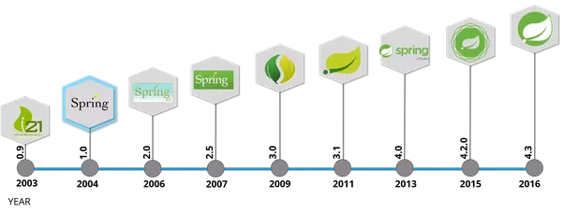
History of Spring Framework
In October 2002 by Rod Johnson;
He proposed a simpler solution based on ordinary java classes (POJO – plain old java objects) and dependency injection (DI or IoC).
In June 2003, spring 0.9 was released under Apache 2.0 license;
Notes:
In traditional class libraries, where user code invokes library code, in this approach framework code in the superclass invokes user code.

Slide 11
Spring Ioc
Section 2

Slide 12
What is Spring Inversion of Control(IoC )?
Let’s first understand the issue, consider the following class:
package com.fsoft.bean;
public class Employee {
private int empId;
private String empName;
private String address;
public Employee() {
}
public Employee(int empId, String empName, String address) {
this.empId = empId;
this.empName = empName;
this.address = address;
}
//getter-setter methods
}

Slide 13
Spring IoC
Standard code that without IoC
package com.fsoft.bean;
public class Client {
public static void main(String[] args) {
Employee employee = new Employee();
employee.setEmpId(1);
employee.setEmpName("John Watson");
employee.setAddress("New York");
System.out.println("Employee details: " + employee);
}
}
Employee
-----
- empId
- empName
- address
------
+ getter
+ setter
Client
-----
+ main()

Slide 14
Spring IoC
With IoC
You don’t create objects. Using Bean Configuration File;
Create an application context where we used framework API ClassPathXmlApplicationContext().
This API loads beans configuration file and based on the provided API, it will create and initialize all the objects.
Employee
-----
- empId
- empName
- address
------
+ getter
+ setter
Client
-----
+ main()
Container

Slide 15
Spring IoC Demo
Start Coding in 5 Simple Steps
Load jar files
Bean Class
XML file
Demo Class
Run

Slide 16
Required Maven Dependency
Add maven dependency in pom.xml file.
<project ...>
<properties>
<project.build.sourceEncoding>UTF-8
</project.build.sourceEncoding>
<spring.version>4.3.10.RELEASE</spring.version>
<junit.version>4.12</junit.version>
<servlet.version>3.1.0</servlet.version>
</properties>
<dependencies>
<!-- Junit -->
<dependency>
<groupId>junit</groupId>
<artifactId>junit</artifactId>
<version>${junit.version}</version>
<scope>test</scope>
</dependency>
<!--Servlet-Api -->
<dependency>
<groupId>javax.servlet</groupId>
<artifactId>javax.servlet-api</artifactId>
<version>${servlet.version}</version>
</dependency>
<!-- Spring Framework -->
<dependency>
<groupId>org.springframework</groupId>
<artifactId>spring-core</artifactId>
<version>${spring.version}</version>
</dependency>
<dependency>
<groupId>org.springframework</groupId>
<artifactId>spring-beans</artifactId>
<version>${spring.version}</version>
</dependency>
<dependency>
<groupId>org.springframework</groupId>
<artifactId>spring-context</artifactId>
<version>${spring.version}</version>
</dependency>

Slide 17
Required Maven Dependency
Add maven dependency in pom.xml file.
<!-- Spring JDBC (if need) -->
<dependency>
<groupId>org.springframework</groupId>
<artifactId>spring-jdbc</artifactId>
<version>${spring.version}</version>
</dependency>
<!-- MS SQL Server (if need) -->
<dependency>
<groupId>com.microsoft.sqlserver</groupId>
<artifactId>mssql-jdbc</artifactId>
<version>6.1.0.jre7</version>
</dependency>
</dependencies>
<build>
<finalName>FRESHERACADEMY</finalName>
</build>
</project>

Slide 18
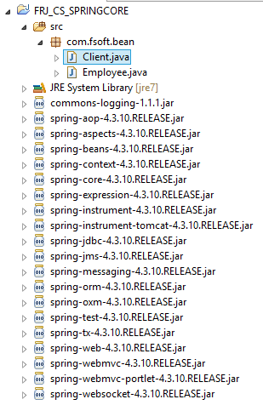
Spring IoC Demo
Create Java Project and Load jar files
Load jar files
Bean Class
XML file
Demo Class
Run

Slide 19
Spring IoC Demo
Create Bean Configuration File
Load jar files
Bean Class
XML file
Demo Class
Run
package com.fsoft.bean;
public class Employee {
private int empId;
private String empName;
private String address;
public Employee() {
}
public Employee(int empId, String empName, String address) {
this.empId = empId;
this.empName = empName;
this.address = address;
}
//getter-setter
}

Slide 20
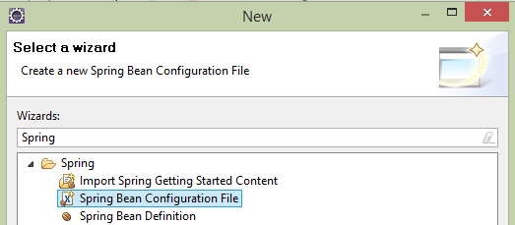
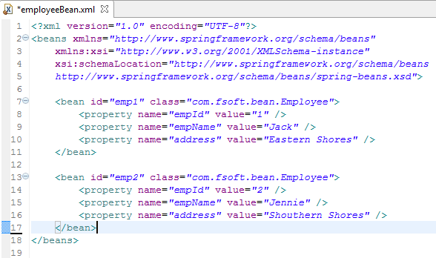
Spring IoC Demo
Create Bean Configuration File
Load jar files
Bean Class
XML file
Demo Class
Run

Slide 21
Spring IoC Demo
Create Source Files
Load jar files
Bean Class
XML file
Demo Class
Run
package com.fsoft.bean;
public class Client {
public static void main(String[] args) {
ApplicationContext context = new
ClassPathXmlApplicationContext("employeeBean.xml");
Employee emp1 = (Employee) context.getBean("emp1");
Employee emp2= (Employee) context.getBean("emp2");
System.out.println("Employee details: " + emp1);
System.out.println("Employee details: " + emp2);
}
}
Result
Initial!
Employee details: Employee [empId=1, empName=Jack, address=Eastern Shores]
Employee details: Employee [empId=2, empName=Jennie, address=Shouthern Shores]
Destroy!

Slide 22
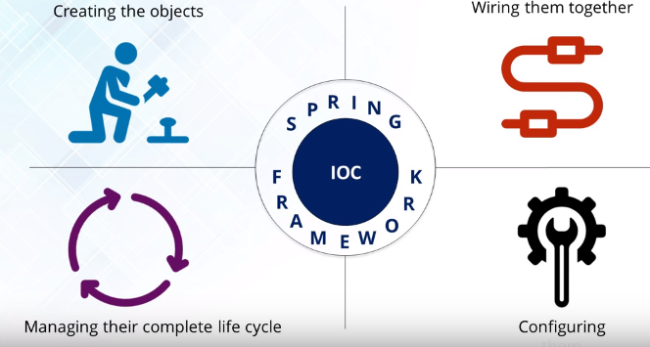
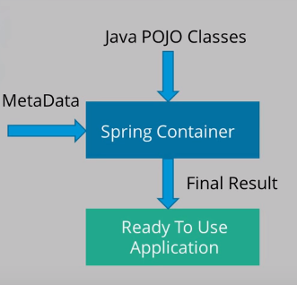
IOC Container Features
IoC
The Spring IoC container by using Java POJO classes and configuration metadata procedures a fully configured and executable system or application.

Slide 23
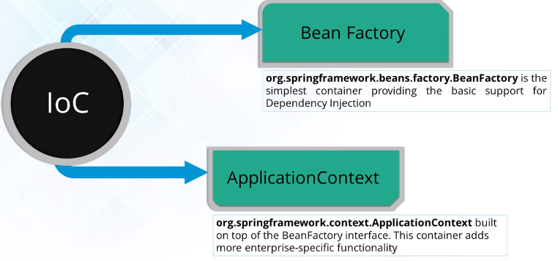
Types Of IoC Container

Slide 24
Spring bean
Section 3

Slide 25
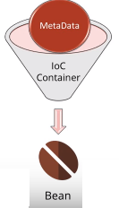
Bean Object
Beans are the objects that form the backbone of our application and are managed by the Spring IoC container.
Spring IoC container instantiates, assembles, and manages the bean object.
The configuration metadata that are supplied to the container are used create Beans object.

Slide 26
Some Bean Properties
Property | Explain
class | This attribute is mandatory and specify the bean class to be used to create the bean.
name | This attribute specifies the bean identifier uniquely. In XML-based configuration metadata, you use the id and/or name attributes to specify the bean identifier(s).
scope | This attribute specifies the scope of the objects created from a particular bean definition.
constructor-arg | This is used to inject the dependencies and will be discussed in subsequent chapters.
properties | Define properties of class.
autowire mode | Set autowire for bean.
lazy-initialization mode | A lazy-initialized bean tells the IoC container to create a bean instance when it is first requested, rather than at startup.

Slide 27
class property
package com.fsoft.bean;
public class Address {
private String city;
private String street;
public Address() {
}
public Address(String city, String street) {
this.city = city;
this.street = street;
}
// getter-setter methods
}
<?xml version="1.0" encoding="UTF-8"?>
<beans xmlns="http://www.springframework.org/schema/beans"
xmlns:xsi="http://www.w3.org/2001/XMLSchema-instance"
xsi:schemaLocation="http://www.springframework.org/schema/beans
http://www.springframework.org/schema/beans/spring-beans.xsd">
<bean id="addr" class="com.fsoft.bean.Address">
<property name="city" value="Hanoi" />
<property name="street" value="Duytan" />
</bean>
</beans>

Slide 28
scope property
Scope | Explain
singleton | (Default) Scopes a single bean definition to a single object instance per Spring IoC container.
prototype | Scopes a single bean definition to any number of object instances.
request | Scopes a single bean definition to the lifecycle of a single HTTP request; that is, each HTTP request has its own instance of a bean created off the back of a single bean definition.
session | Scopes a single bean definition to the lifecycle ofcan HTTP Session. Only valid in the context of acweb-aware Spring ApplicationContext.
global session | Scopes a single bean definition to the lifecycle of a global HTTP Session. Typically only valid when used in a portlet context. Only valid in the context of a web-aware Spring ApplicationContext.

Slide 29
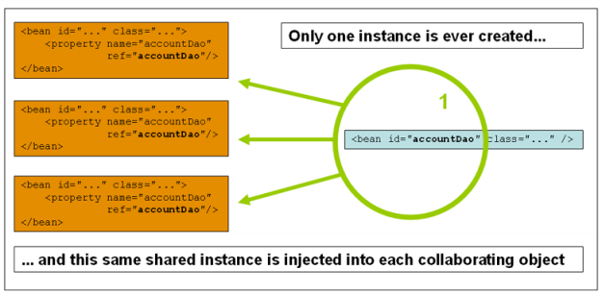
scope property
Scope “singleton”

Slide 30
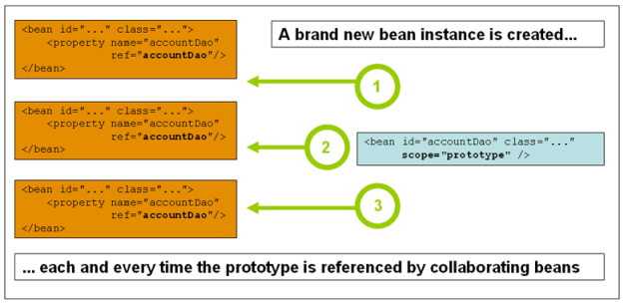
scope property
Scope “prototype”

Slide 31
Spring DI
Section 4

Slide 32
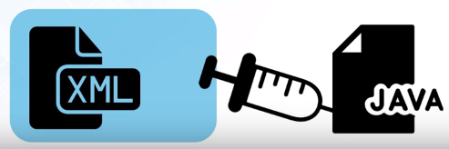
Dependency Injection (DI)
It is a design pattern which removes the dependency from the programming code, that makes the Application easy to manage and test.
Dependency Injection makes our programming code loosely coupled, which means change in implementation doesn't affects the use.

Slide 33
Spring DI
Consider you have an application which has a employee component and you want to identify a their address.
Your standard code would look something like this:
public class Employee {
private int empId;
private String empName;
private Address address; // HAS-A relationship
/*private String address;*/
public Employee() {
this.empId = 0;
this.empName = "N/A";
this.address = new Address();
}
}

Slide 34
Spring DI
Let's create a dependency between the Employee and the Address.
In an IoC scenario, we would instead do something like this:
We can inject the dependancies using the setter or constructor injection.
public class Employee {
private int empId;
private String empName;
private Address address; // HAS-A relationship
public Employee(Address address) {
super();
this.address = address;
}
public void setAddress(Address address) {
this.address = address;
}
}

Slide 35
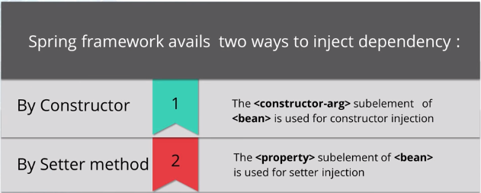
Type of Dependency Injection

Slide 36
Spring DI Demo
By Constructor
<?xml version="1.0" encoding="UTF-8"?>
<beans xmlns="http://www.springframework.org/schema/beans"
xmlns:xsi="http://www.w3.org/2001/XMLSchema-instance"
xsi:schemaLocation="http://www.springframework.org/schema/beans
http://www.springframework.org/schema/beans/spring-beans.xsd">
<bean id="addr" class="com.fsoft.bean.di.Address">
<property name="city" value="Hanoi" />
<property name="street" value="Duytan" />
</bean>
<bean id="emp3" class="com.fsoft.bean.di.Employee">
<property name="empId" value="3"/>
<property name="empName" value="My"/>
<property name=" address " ref="addr">/> <--setter-->
<constructor-arg name="address" ref="addr“ />
</bean>
</beans>
Using <constructor-arg> subelement to initialize instance variables

Slide 37
Spring DI Demo
By Setter
<?xml version="1.0" encoding="UTF-8"?>
<beans xmlns="http://www.springframework.org/schema/beans"
xmlns:xsi="http://www.w3.org/2001/XMLSchema-instance"
xsi:schemaLocation="http://www.springframework.org/schema/beans
http://www.springframework.org/schema/beans/spring-beans.xsd">
<bean id="addr" class="com.fsoft.bean.di.Address">
<property name="city" value="Hanoi" />
<property name="street" value="Duytan" />
</bean>
<bean id="emp4" class="com.fsoft.bean.di.Employee">
<property name="empId" value="4"/>
<property name="empName" value="My"/>
<property name="address" ref="addr“ />
</bean>
</beans>
Using <property> subelement to initialize instance variables

Slide 38
Spring IOC and DI
Ways of implement IOC
IOC
DI
Constructor
Setter/Getter
Interface Implementation
Service Locator

Slide 39
SpEL
Section 5

Slide 40
Spring EL
The Spring Expression Language (SpEL for short) is a powerful expression language that supports querying and manipulating an object graph at runtime.
The Spring EL is similar with OGNL and JSF EL, and evaluated or executed during the bean creation time.
All Spring expressions are available via XML or annotation.

Slide 41
SpEL in XML based configuration
The SpEL are enclosed with #{ SpEL expression }:
<?xml version="1.0" encoding="UTF-8"?>
<beans xmlns="http://www.springframework.org/schema/beans"
xmlns:xsi="http://www.w3.org/2001/XMLSchema-instance"
xsi:schemaLocation="http://www.springframework.org/schema/beans
http://www.springframework.org/schema/beans/spring-beans.xsd">
<bean id="addr" class="com.fsoft.bean.di.Address">
<property name="city" value="Hanoi" />
<property name="street" value="Duytan" />
</bean>
<bean id="employee" class="com.fsoft.bean.di.Employee">
<property name="empId" value="12"/>
<property name="empName" value="My"/>
<property name="address" value="#{addr}"></property>
</bean>
</beans>

Slide 42
SpEL in Annotation-based configuration
package com.fsoft.bean;
import org.springframework.beans.factory.annotation.Value;
@Component("addr")
public class Address {
@Value("Hanoi")
private String city;
@Value("Duytan")
private String street;
public Address() {
}
// ...
}

Slide 43
Spring EL in Annotation
To use SpEL in annotation, you must register your component via annotation. If you register your bean in XML and define @Value in Java class, the @Value will failed to execute.
<?xml version="1.0" encoding="UTF-8"?>
<beans xmlns="http://www.springframework.org/schema/beans"
xmlns:xsi="http://www.w3.org/2001/XMLSchema-instance"
xsi:schemaLocation="http://www.springframework.org/schema/beans http://www.springframework.org/schema/beans/spring-beans.xsd"
xmlns:context="http://www.springframework.org/schema/context http://www.springframework.org/schema/context/spring-context- 3.0.xsd" >
<context:component-scan base-package="com.fsoft.bean" />
// ...
</beans?

Slide 44
SUMMAY
1
Overview of the Spring Framework
2
Spring IoC
3
Spring Bean
Dependency Injection
4
5
SpEL

Slide 45

Thank you
45

